Slide 1


Consumer Goods Ad-Hoc Insights
ATLIQ MART

Slide 2
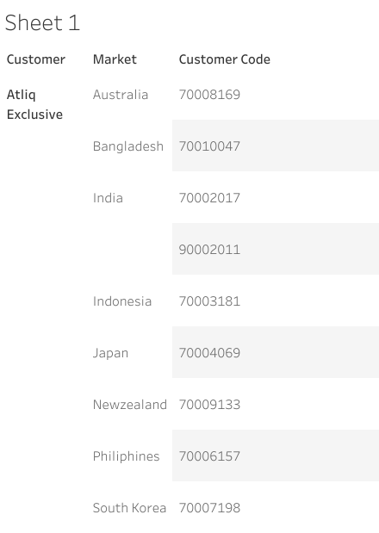
Atliq excusive Markets In “APAC” Region
Question:Provide the list of markets in which customer "Atliq Exclusive" operates its business in the APAC region.

Slide 3
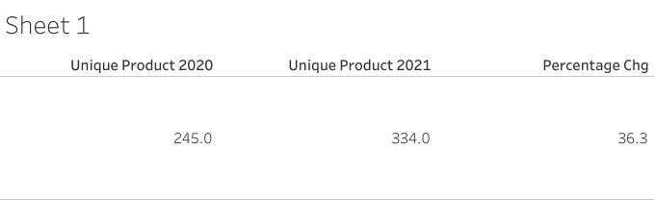
Unique Product Increase 2021 vs 2020
Question:. What is the percentage of unique product increase in 2021 vs. 2020?

Slide 4
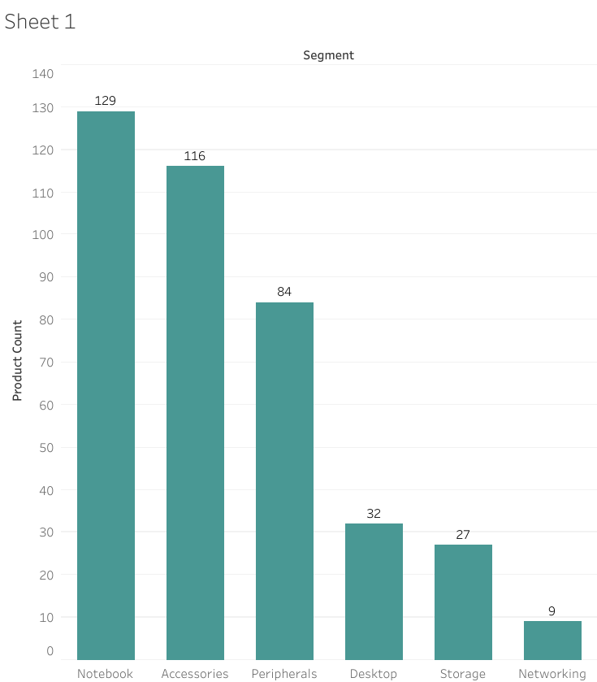
Unique Product Count In Segment
Question:. Provide a report with all the unique product counts for each segment and sort them in descending order of product counts.

Slide 5
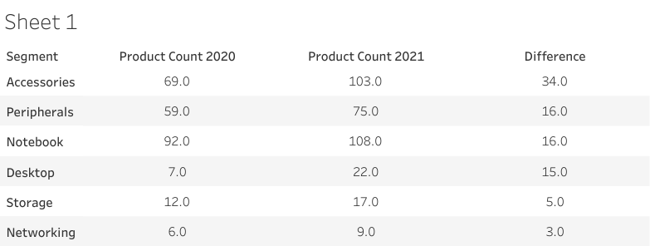
Segment Wise Increase In Products 2021vs 2020
Qusetion:Which segment had the most increase in unique products in 2021 vs 2020?

Slide 7
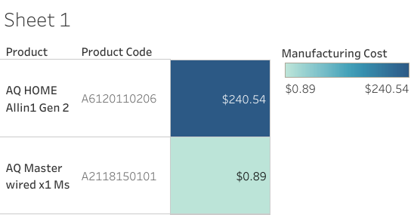
Highest and Lowest Manufacturing Cost For Product
Get the products that have the highest and lowest manufacturing costs.

Slide 8
Top 5 Customers Receive Pre_invoice_discount In Indian Market In Year 2021
Question: Generate a report which contains the top 5 customers who received an average high pre_invoice_discount_pct for the fiscal year 2021 and in the Indian market.
customer_code | customer | average_discount_percentage
90002009 | Flipkart | 0.3083
90002006 | Viveks | 0.3038
90002003 | Ezone | 0.3028
90002002 | Croma | 0.3025
90002016 | Amazon | 0.2933

Slide 9
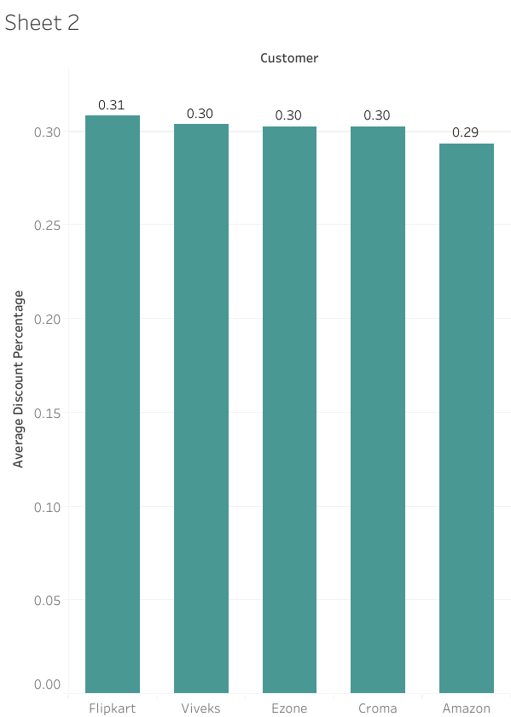

Slide 10
Monthly Grass Sales Amount For” Atliq Exclusive”
Question: Get the complete report of the Gross sales amount for the customer “Atliq Exclusive” for each month.
Month | year | customer | Gross Sales Amount
9 | 2019 | Atliq Exclusive | 9092670.339
10 | 2019 | Atliq Exclusive | 10378637.6
11 | 2019 | Atliq Exclusive | 15231894.97
12 | 2019 | Atliq Exclusive | 9755795.058
1 | 2020 | Atliq Exclusive | 9584951.939
2 | 2020 | Atliq Exclusive | 8083995.548
3 | 2020 | Atliq Exclusive | 766976.4531
4 | 2020 | Atliq Exclusive | 800071.9543
5 | 2020 | Atliq Exclusive | 1586964.477
6 | 2020 | Atliq Exclusive | 3429736.571
7 | 2020 | Atliq Exclusive | 5151815.402
8 | 2020 | Atliq Exclusive | 5638281.829
9 | 2020 | Atliq Exclusive | 19530271.3
10 | 2020 | Atliq Exclusive | 21016218.21
11 | 2020 | Atliq Exclusive | 32247289.79
12 | 2020 | Atliq Exclusive | 20409063.18
1 | 2021 | Atliq Exclusive | 19570701.71
2 | 2021 | Atliq Exclusive | 15986603.89
3 | 2021 | Atliq Exclusive | 19149624.92
4 | 2021 | Atliq Exclusive | 11483530.3
5 | 2021 | Atliq Exclusive | 19204309.41
6 | 2021 | Atliq Exclusive | 15457579.66
7 | 2021 | Atliq Exclusive | 19044968.82
8 | 2021 | Atliq Exclusive | 11324548.34

Slide 11
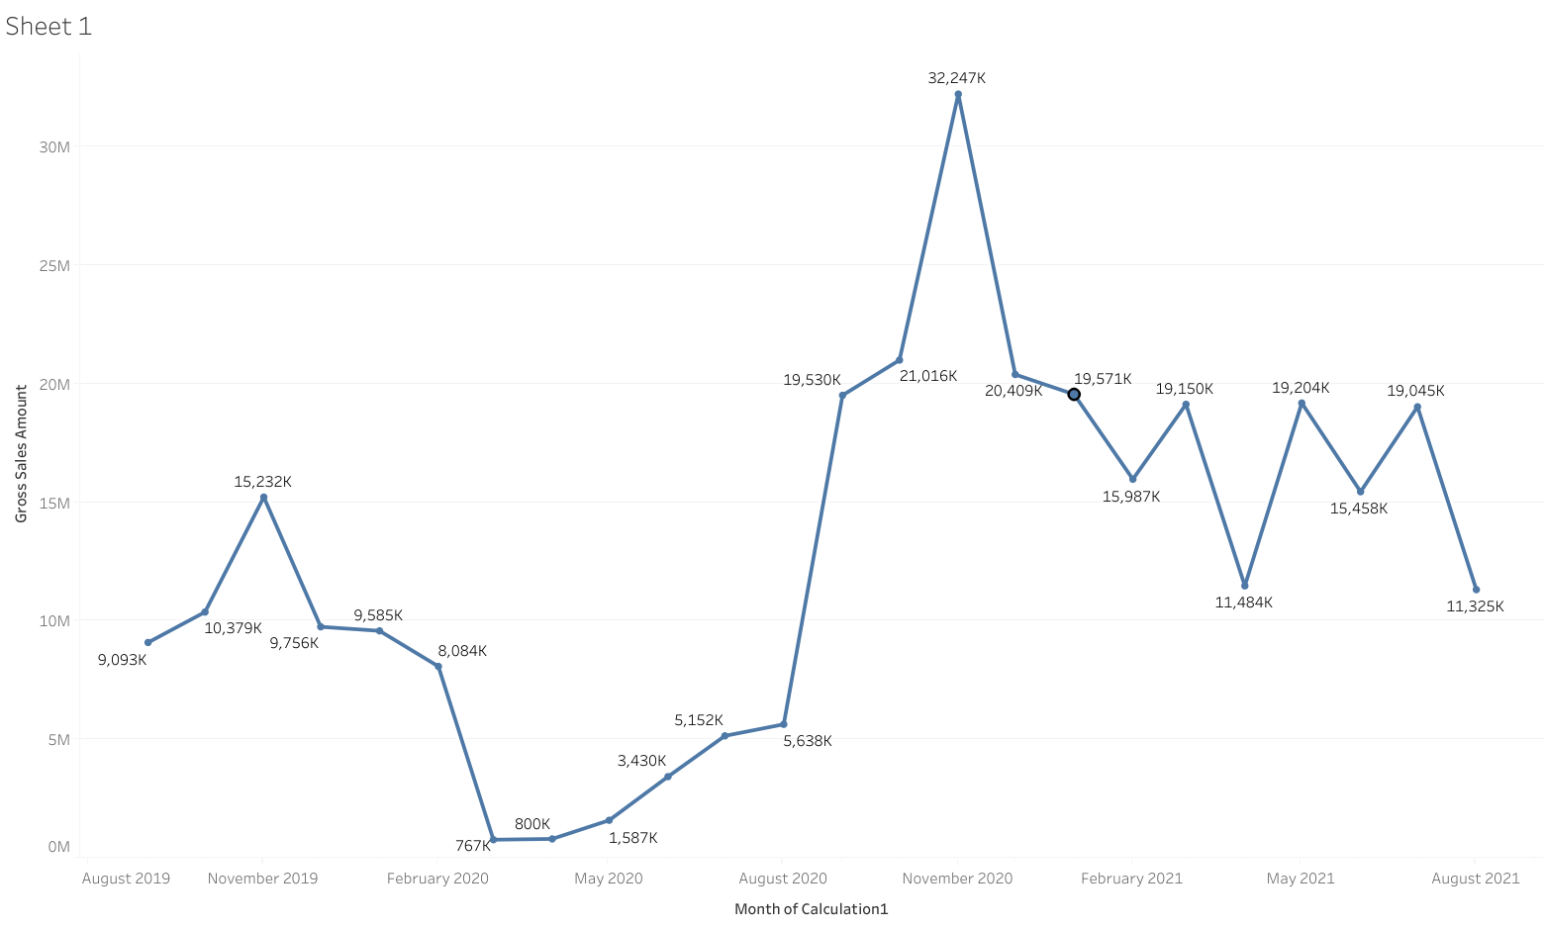

Slide 12
“Maximum Total_sold_Quantity
Question: In which quarter of 2020, got the maximum total_sold_quantity?
Quarter | total_sold_quantity
Q1 | 3704398
Q2 | 3395899
Q3 | 7137551
Q4 | 17447125
Quarter | total_sold_quantity
Q4 | 17447125

Slide 13
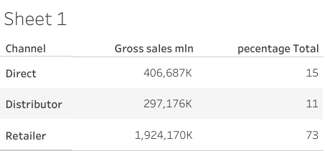
Gross Sales By Channel In Year 2021
Which channel helped to bring more gross sales in the fiscal year 2021 and the percentage of contribution?

Slide 14
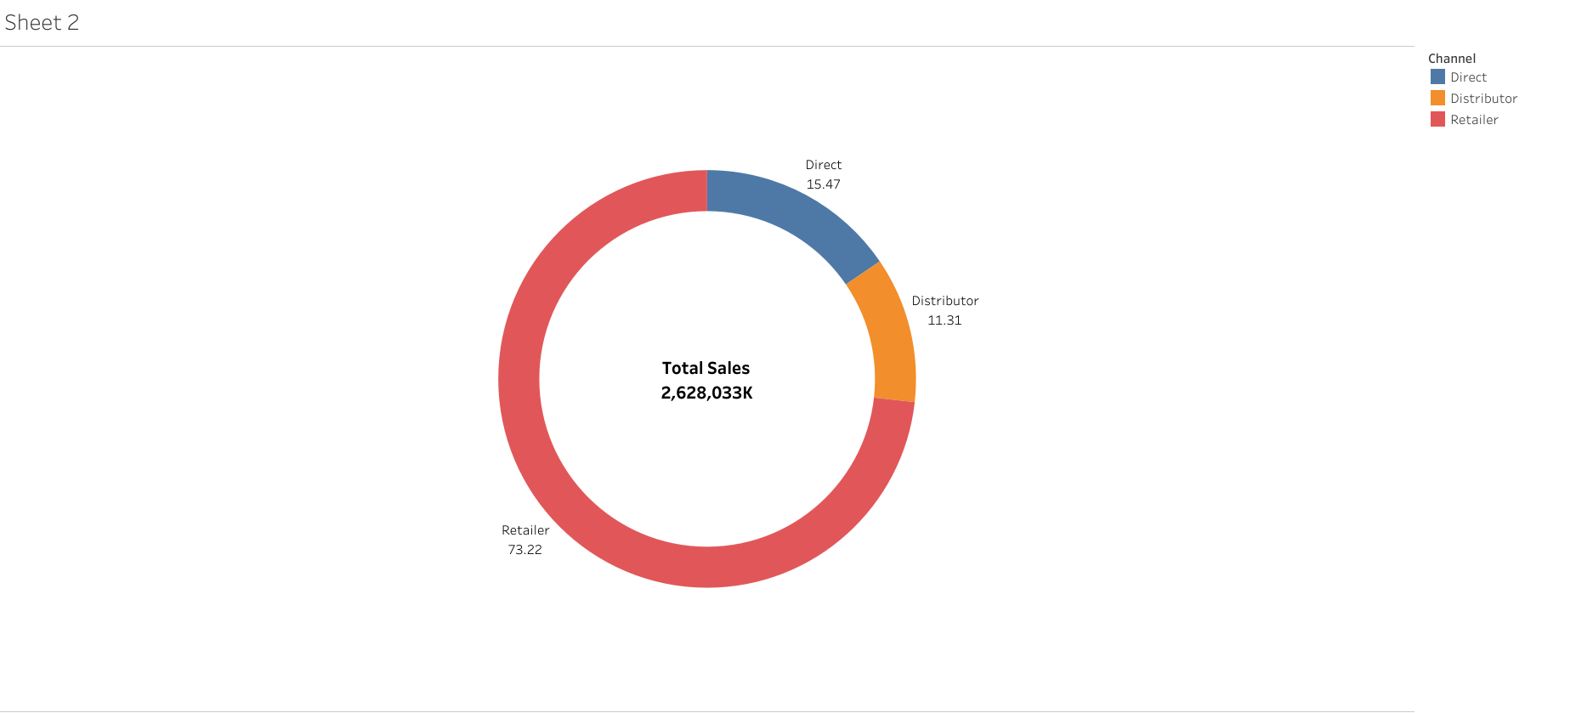

Slide 15
Top 3 Products In Each Division By Total_Sold_Quantity
Question:Get the Top 3 products in each division that have a high total_sold_quantity in the fiscal_year 2021?
product_code | total_sold_quantity | division | product | rank_order
A6720160103 | 701373 | N & S | AQ Pen Drive 2 IN 1 | 1
A6818160202 | 688003 | N & S | AQ Pen Drive DRC | 2
A6819160203 | 676245 | N & S | AQ Pen Drive DRC | 3
A2319150302 | 428498 | P & A | AQ Gamers Ms | 1
A2520150501 | 419865 | P & A | AQ Maxima Ms | 2
A2520150504 | 419471 | P & A | AQ Maxima Ms | 3
A4218110202 | 17434 | PC | AQ Digit | 1
A4319110306 | 17280 | PC | AQ Velocity | 2
A4218110208 | 17275 | PC | AQ Digit | 3

